Slide 1

Asymptotic Notations, Time Space trade-off
Data Structure | Introduction to Data Structure
Course: Data Structure | Chapter: Introduction to Data Structure | Program: Bachelor of Engineering
DISCOVER · LEARN · EMPOWER
Notes:
Welcome everyone to today's lecture on Data Structures. We will focus on how to measure algorithm efficiency using Asymptotic Notations. We will also discuss the critical balance between time and space. This foundation is essential for analyzing any algorithm you write.

Slide 2
Course Outcomes
SLIDE 2 / 10
Course Outcome
CO | BT LEVEL | DESCRIPTION
CO1 | BT1 | Understand and apply basic data structures, algorithms, complexity analysis, ADTs, arrays and linked lists.
CO2 | BT2 | Apply and implement stacks and queues in problem-solving.
CO3 | BT3 | Analyse and apply searching, sorting, and hashing techniques.
CO4 | BT4 | Construct and apply tree structures and traversal techniques.
CO5 | BT5 | Represent and solve graph problems using DFS, BFS, and graph algorithms.
Chandigarh University
2 / 10
Notes:
Today's lecture directly supports our Course Outcomes. By understanding asymptotic notations, you will be able to analyze searching and sorting techniques effectively. This knowledge also helps in constructing efficient tree structures and their traversal methods. We will apply these concepts to real-world algorithmic problems.

Slide 3
Learning Objectives
SLIDE 3 / 10
Learning Outcomes
1
Define asymptotic notations and their role in algorithm analysis.
2
Differentiate between Big-O, ω, and θ notations clearly.
3
Analyze the time complexity of basic operations using these notations.
4
Evaluate the trade-off between execution time and memory usage.
5
Apply these concepts to select optimal algorithms for specific problems.
Chandigarh University
3 / 10
Notes:
By the end of this session, you will be able to define and differentiate the three main asymptotic notations. You will learn to analyze time complexity for common operations like searching. We will also evaluate how memory usage impacts execution speed. Finally, you will apply these concepts to choose the best algorithm for a given problem.

Slide 4
Lecture
SLIDE 4 / 10
Definition of Asymptotic Notations
1
Asymptotic notations describe the limiting behavior of a function.
2
They measure algorithm efficiency as input size approaches infinity.
3
These notations ignore constant factors and lower-order terms.
4
They provide a standardized way to compare algorithm performance.
5
The focus is on growth rate rather than exact execution time.
Chandigarh University
4 / 10
Notes:
Think of asymptotic notations as a way to predict how an algorithm scales. If you double the input size, how much longer does it take? We ignore small constants because they matter less for huge datasets. This allows us to compare algorithms fairly regardless of the specific computer used.

Slide 5
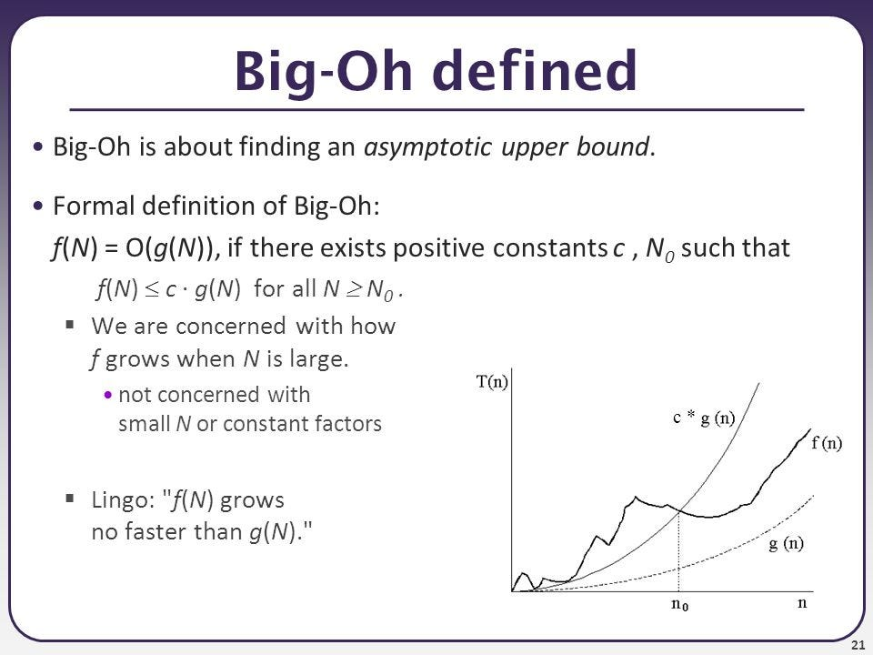
Lecture
SLIDE 5 / 10
Big-O Notation (Upper Bound)
GOVERNING EQUATION
Formally, f(n) = O(g(n)) if f(n) ≤ c·g(n) for large n
EXAMPLE
Linear search has a worst-case time of O(n).
• Big-O notation defines the worst-case scenario for an algorithm.
• It represents the upper bound on the growth rate of time.
• It guarantees the algorithm will not take longer than this bound.
Source: miro.medium.com
Chandigarh University
5 / 10
Notes:
Big-O is the most common notation used in computer science. It tells you the maximum time an algorithm will take. For example, if you search a list of 1000 items, the worst case is checking every item. This gives us a safety guarantee for our program's performance.

Slide 6
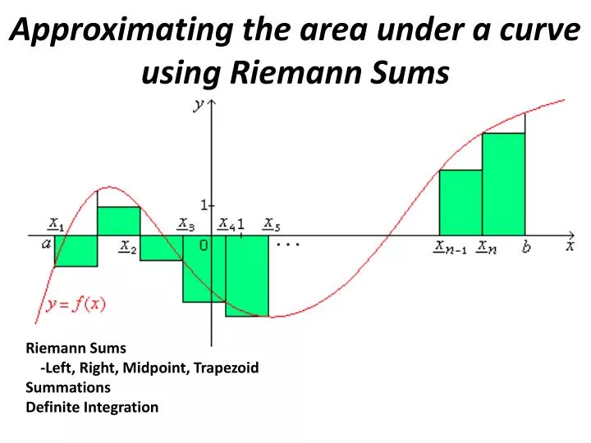
Lecture
SLIDE 6 / 10
ω and θ Notations
GOVERNING EQUATION
f(n) = Ω(g(n)) means f(n) grows at least as fast as g(n)
1
ω notation defines the best-case scenario or lower bound.
2
θ notation defines the tight bound where best and worst match.
3
f(n) = Θ(g(n)) means f(n) grows exactly like g(n).
4
θ provides a precise characterization of the algorithm's growth.
Source: cdn1.slideserve.com
Chandigarh University
6 / 10
Notes:
While Big-O gives the worst case, ω gives the best case. θ is very useful when the best and worst cases are similar. For instance, binary search always takes logarithmic time regardless of the input. This makes θ the most accurate description for such algorithms.

Slide 7
Lecture
SLIDE 7 / 10
Time Complexity Examples
1
Constant time O(1) operations take the same time regardless of input.
2
Logarithmic time O(log n) grows very slowly with input size.
3
Linear time O(n) grows directly proportional to the input size.
4
Quadratic time O(n²) grows rapidly and is inefficient for large data.
5
Exponential time O(2ⁿ) is generally impractical for large inputs.
Chandigarh University
7 / 10
Notes:
Let's look at common complexities. Accessing an array element is O(1) because it takes one step. Binary search is O(log n) because it halves the search space each time. A nested loop often results in O(n²), which becomes slow quickly. Understanding these helps you avoid performance bottlenecks.

Slide 8
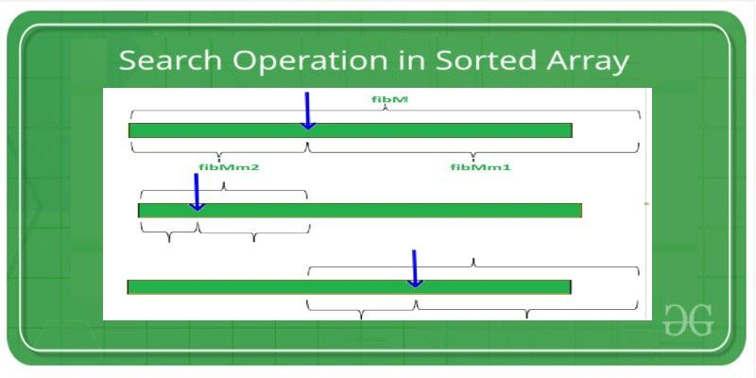
Worked Example
SLIDE 8 / 10
Linear Search
BEST CASE
Element found at index 0, taking 1 comparison.
WORST CASE
Element at end or missing, taking n comparisons.
AVERAGE CASE
Element found at middle, taking n/2 comparisons.
• Consider a linear search on an array of size n.
• All cases simplify to O(n) for asymptotic analysis.
Source: media.geeksforgeeks.org
Chandigarh University
8 / 10
Notes:
Let's work through a linear search example. If the array has 100 elements, the best case is finding the item immediately. The worst case requires checking all 100 items. Even though the average is 50, we drop the constant and write O(n). This shows why we focus on the growth rate.

Slide 9

Lecture
SLIDE 9 / 10
Time-Space Trade-off
EXAMPLE
Caching results speeds up queries but consumes more RAM.
• Time-space trade-off balances execution speed against memory usage.
• Reducing time often requires increasing space for caching or lookup tables.
• Increasing space can optimize time by avoiding repeated calculations.
• Designers must choose based on system constraints and requirements.
Source: png.pngtree.com
Chandigarh University
9 / 10
Notes:
In real-world systems, you often have to choose between speed and memory. If you have plenty of RAM, you can store pre-calculated results to save time. However, if memory is limited, you might need to recalculate values, which slows down the program. This trade-off is a key design decision in data structures.

Slide 10
Lecture
SLIDE 10 / 10
References
DATA STRUCTURES
A Pseudocode Approach with C — Gilberg, Forouzan
• Data Structures — Lipschutz
• Data Structure Using C — AK Sharma
• C and Data structure — P. S. Deshpandey
Chandigarh University
10 / 10
Notes:
These textbooks provide comprehensive coverage of the topics discussed today. I recommend reading the chapters on algorithm analysis for deeper insights. They contain numerous examples and exercises to reinforce your understanding. Please refer to these resources for your assignments and exams.

